Slide 1
Network Layer: Internet Protocol, Version 6 (IPv6)
Lecture 15 | Part 1 | CSE421 – Computer Networks
Department of Computer Science and Engineering School of Data & Science

Slide 2
IPv6
Initial motivation:
32-bit address space soon to be completely allocated.
Additional motivation:
Simpler header format helps speed processing/forwarding
header changes to facilitate QoS

Slide 3
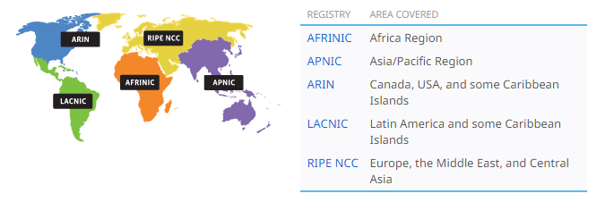
IPv4 Allocation Authority

Slide 4
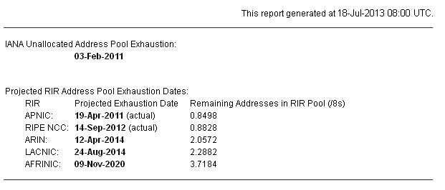
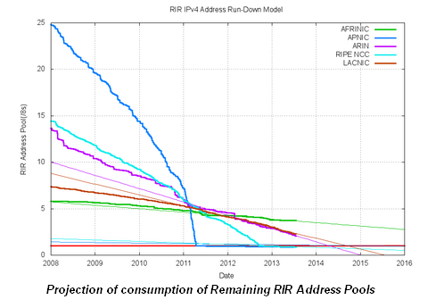
IPv4 Address Exhaustion

Slide 5
Reasons for using IPv6
Address Availability:
IPv4: 4 octets - 32 bits
2^32 or 4,294,467,295 IP Addresses.
IPv6: 16 octets - 128 bits
3.4 x 10^38 or
340,282,366,920,938,463,463,374,607,431,768,211,456
(340 undecillion) IP Addresses.
Every atom of every person on Earth could be assigned 7 unique addresses with some to spare (assuming 7 × 10²⁷ atoms per human x 6.5 Billion).

Slide 6
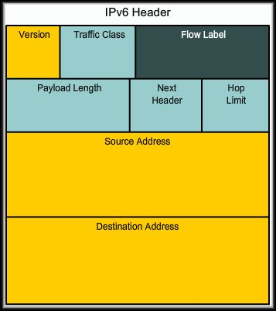
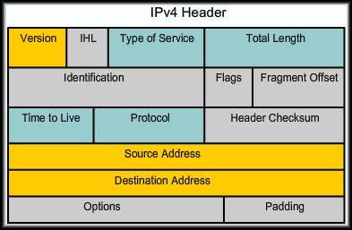
Reasons for Using IPv6
IPv6 Features:
fixed-length 40 byte header
no fragmentation allowed

Slide 7
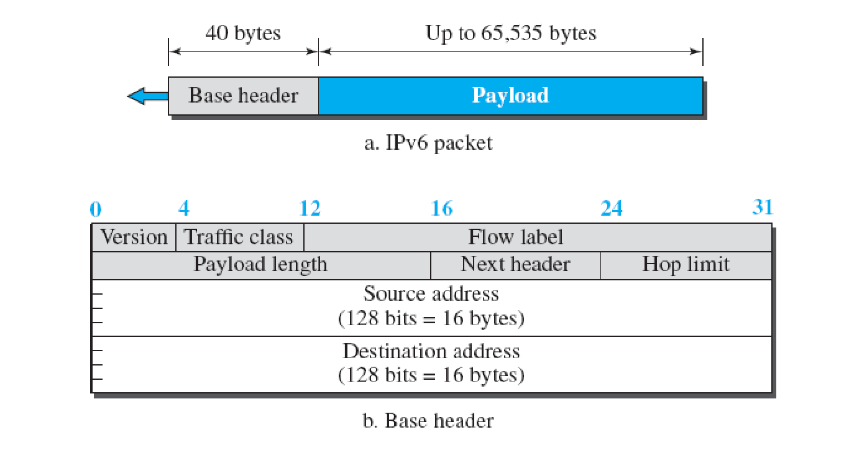
IPv6 Datagram
40 Octets, 8 fields

Slide 8
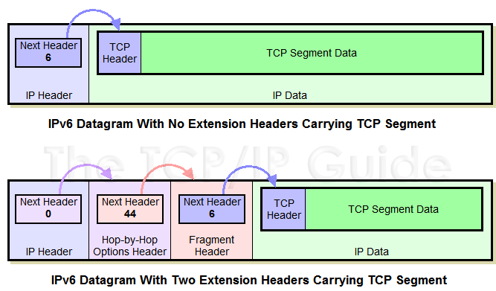
Extension Headers

Slide 9
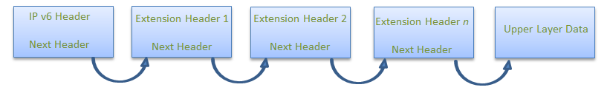
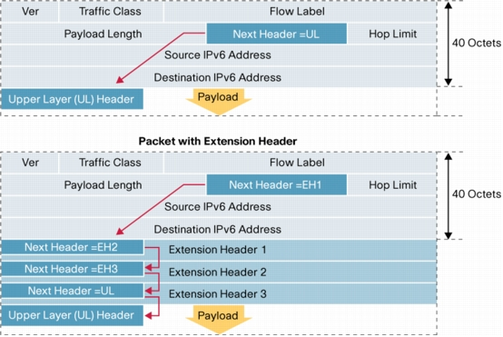
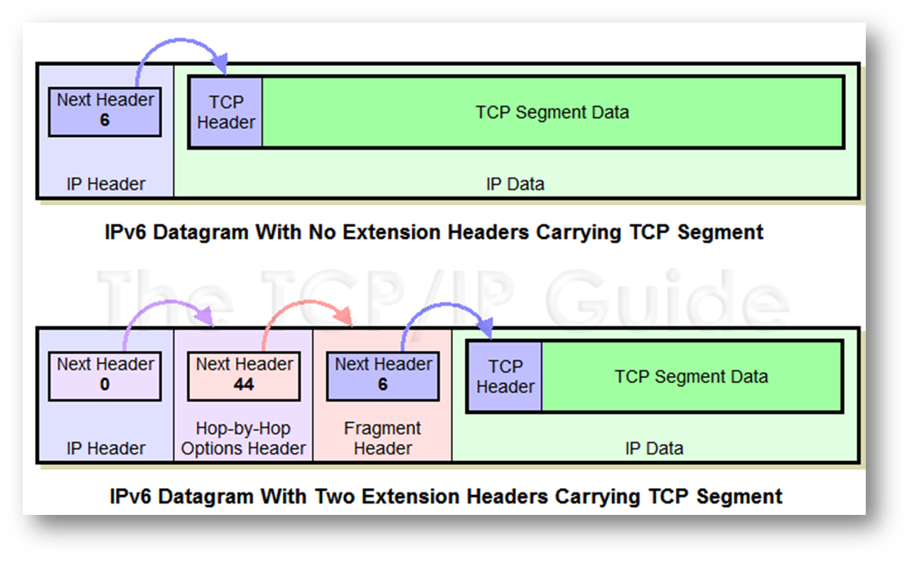
Extension Headers

Slide 10
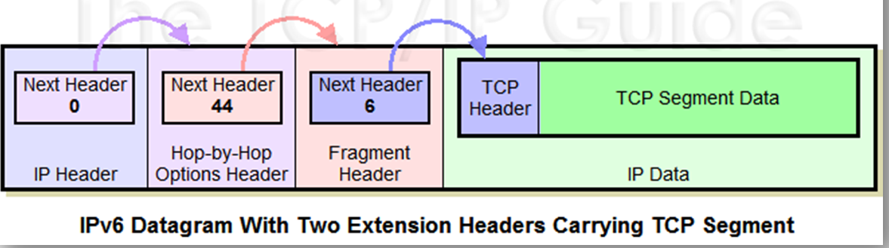
Extension Headers
Basic header simplified for ease of processing
Additional information carried in extension headers
Hop-by-hop options
Routing header
Fragment header
Destination options header
Authentication header (AH)‏
Encrypted security payload (ESP) header
Next Header field says what type of header follows
E.g. Fragment Header, TCP, ICMP, etc.

Slide 11
The IPv4 Header
0
4
8
16
24
31
Ver
IHL
Service Type
Total Length
Identifier
Flags
Fragment Offset
Time to Live
Protocol
Header Checksum
32 bit Source Address
32 bit Destination Address
Options and Padding
shaded fields are absent from IPv6 header

Slide 12
Header Changes between IPv4 and IPv6
Revised
Time to Live (Hop Limit)
Addresses increased from 32 bits to 128 bits
Protocol (Next Header)
Precedence & TOS (Traffic Class)
Extended
Flow Label field added

Slide 13
End of Part1

Slide 14
IPv6 Address
Lecture 15 | Part 2 | CSE421 – Computer Networks

Slide 15


IPv6 Address
128 bits
given below is a 128 bit IPv6 address represented in binary format and divided into eight 16-bits blocks
Each block is then converted into Hexadecimal and separated by ‘:’ symbol
Called string notation

Slide 16
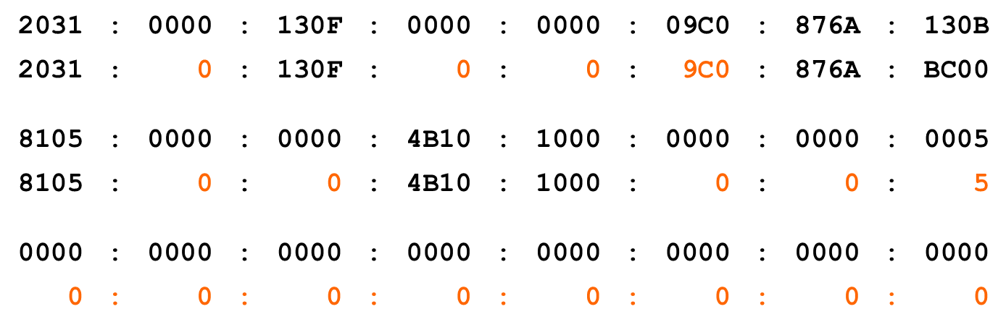
IPv6 Addressing
IPv6 Representation – Rule 1:
The leading zeroes in any 16-bit segment do not have to be written. If any 16-bit segment has fewer than four hexadecimal digits, it is assumed that the missing digits are leading zeroes.

Slide 17
IPv6 Addressing
IPv6 Representation – Rule 2:
Any single, contiguous string of one or more 16-bit segments consisting of all zeroes can be represented once with a double colon.
1080:0:0:0:8:800:200C:417A | = | 1080::8:800:200C:417A
FF01:0:0:0:0:0:0:101 | = | FF01::101
0:0:0:0:0:0:0:1 | = | ::1
0:0:0:0:0:0:0:0 | = | ::
17

Slide 18
IPv6 Addressing
IPv6 Representation – Rule 2:
Any single, contiguous string of one or more 16-bit segments consisting of all zeroes can be represented once with a double colon.
Example: 1843:f01::22::fa
Illegal because the length of the two all-zero strings is ambiguous.
1843:00f0:0000:0000:0022:0000:0000:00fa
1843:00f0:0000:0000:0000:0022:0000:00fa
1843:00f0:0000:0022:0000:0000:0000:00fa
or
or
18

Slide 19
Representing IPv6 addresses
No more net masks
Represented by a “/prefixlen” appended to the end of an address where prefixlen indicates the number of bits in the address that make up the network address
Similar to classless address representation in IPv4
For example:
2001:db8:abcd:0012::0/64 specifies a subnet with a range of IP addresses from:
2001:db8:abcd:0012:0000:0000:0000:0000 to 2001:db8:abcd:0012:ffff:ffff:ffff:ffff.
Network part : 2001:db8:abcd:0012
Host part : ::0

Slide 20
Types of IPv6 addresses
unicast
communicate specified 1 computer
multicast
communicate group of computers
anycast
send group address that can receive multiple computers, but receive 1 computer
g
a
s
d
s
s
g
a
g
a
20
unicast
multicast
anycast

Slide 21
Types of IPv6 addresses
Unlike IPv4, there is no broadcast address.
There is an “all nodes multicast” which serves the same purpose.

Slide 22
Unicast Global Addresses
These are assigned by the IANA and used on public networks.
They are equivalent to IPv4 global (sometimes called public) addresses.
Typically they start at 2000::/3

Slide 23
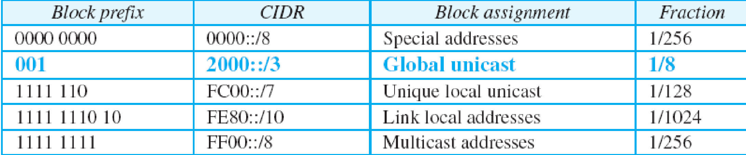
Unicast addresses
A unicast address is an address that identifies a single device.
Types of Unicast Addresses:

Slide 24

Unicast Global Addresses
The host portion of the address is called the Interface ID.
Can contain:
The interface’s 48-bit MAC Address.
An identifier derived from the EUI-64 Address (more later).
A manually configured address.
24

Slide 25
Unicast Global Addresses
ICANN
Device
Subnet
RIR
RIR
Site
Device
ISP
Subnet
LIR
LIR
Site
25
ISP

Slide 26

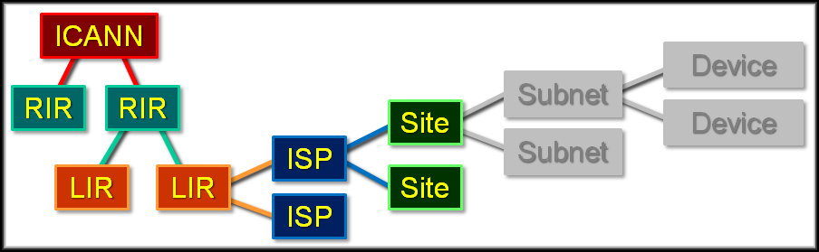
Unicast Global Addresses
Network Portion:
26

Slide 27

Unicast Global Addresses
Begins with binary 001.
More easily recognized as beginning with a hexadecimal 2 or 3.
0010 xxxx or 0011 xxxx
ICANN assigns global unicast IPv6 addresses as public and globally-unique IPv6 addresses.
No need for NAT..
27

Slide 28

Unicast Global Addresses
ICANN or RIR - /23
Device - /64
Site - /48
Site Subnets - /16
LIR or ISP - /32
28

Slide 29
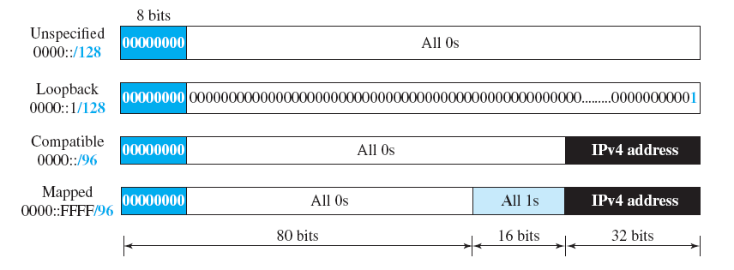
Special Addresses
Unspecified Address:
::/128
In a host, it refers to the host itself, and is used when a device does not know its own address
For addressing purposes within a software. .
Loopback Address
::1/128
loopback (same as 127.0.0.1 in many IPv4 implementations)
In IPv6 there is just one address, not a whole block, for this function.

Slide 30
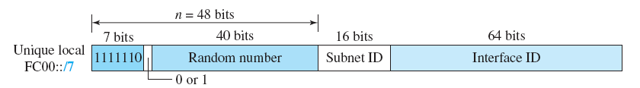
Unique Local Unicast Address
FC00::/7
Globally unique,
But it should be used in local communication.

Slide 31
Link Local Unicast Address
FE80::/10
These addresses refer only to a particular physical network.
Routers do not forward datagrams using link-local addresses.
They are only for local communication on a particular physical network segment.
Automatic address configuration.
Neighbor discovery.
Router discovery. etc

Slide 32
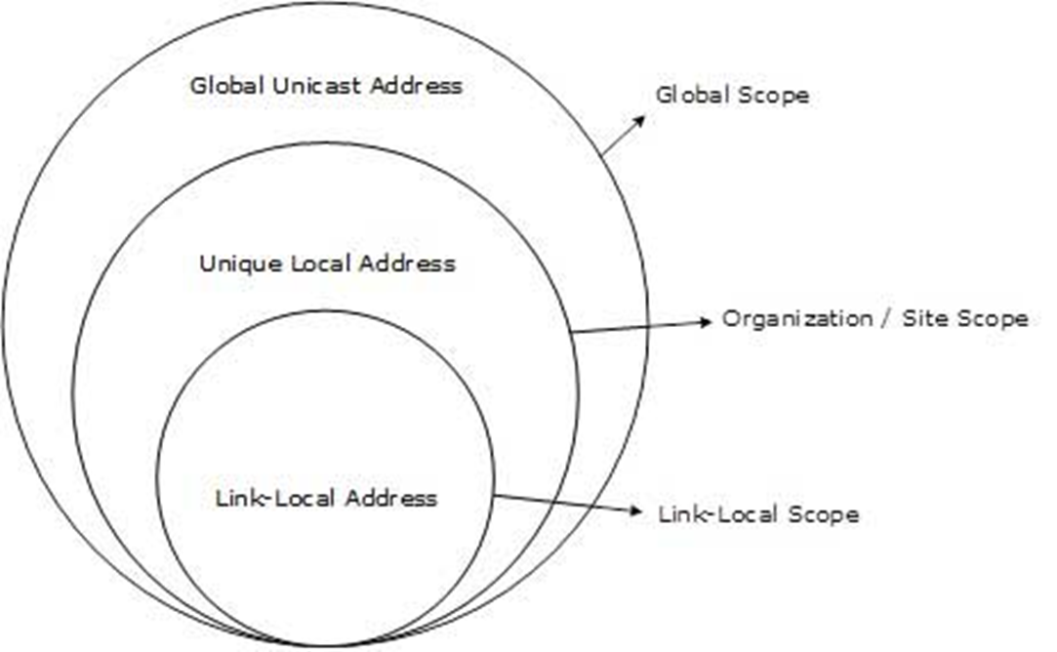
Scope of IPv6 Unicast Addresses

Slide 33
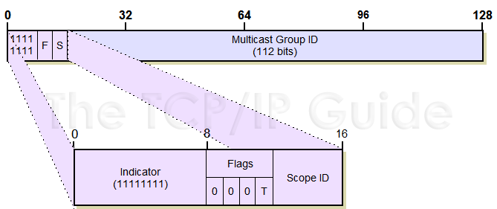
Multicast Addresses
Consisting of all addresses that begin with “1111 1111” i.e “FF”
33

Slide 34
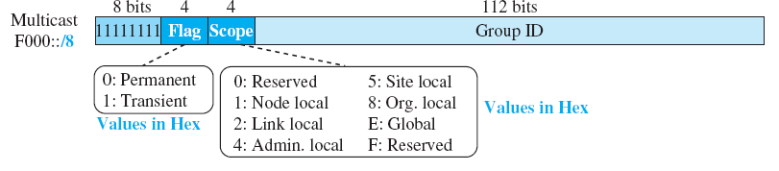
Multicast Addresses
Multicast addresses are used to send data to a number of devices on an internetwork simultaneously.
Each multicast address can be specified for a variety of different scopes
allowing a transmission to be targeted to either a wide or narrow audience of recipient devices.
34

Slide 35
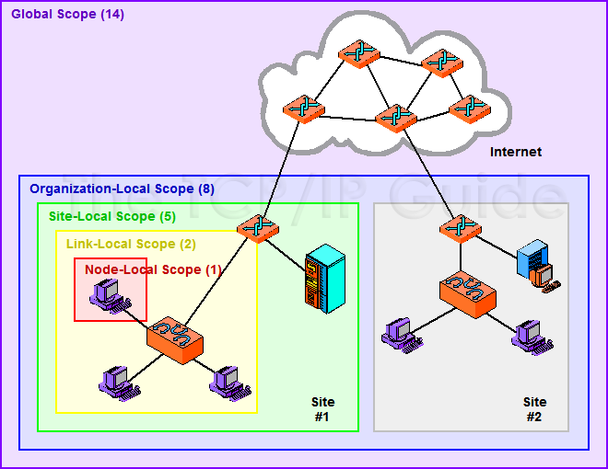

Multicast Scopes
35

Slide 36
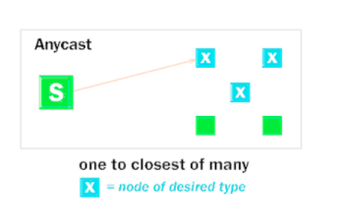
Anycast Addresses
To provide flexibility in situations where we need a service that is provided by a number of different servers or routers but don't really care which one provides it.
In routing, anycast allows datagrams to be sent to whichever router in a group of equivalent routers is closest
36

Slide 37
Anycast Addresses
There is no special anycast addressing scheme: anycast addresses are the same as unicast addresses.
An anycast address is created “automatically” when a unicast address is assigned to more than one interface.
37

Slide 38
Anycast Addresses
Like multicast, anycast creates more work for routers; it is more complicated than unicast addressing.
Due to the relative inexperience of the Internet community in using anycast,
for the present time anycast addresses are used only by routers and not individual hosts.
38

Slide 39
IPv6 Address Management
IPv6 addresses use Interface Identifiers to identify interfaces on a link.
Think of them as the host portion of an IPv6 address.
Four methods of address assignment:
Static assignment using a manual interface ID.
Static assignment using an EUI-64 interface ID.
Stateless Address Auto configuration (SLAAC)
Stateless/Stateful DHCP for IPv6 (DHCPv6)
39

Slide 40
Static Address Management
In order to enable IPv6 on a router
Corp(config)#ipv6 unicast-routing
IPv6 isn’t enabled by default
After going to the interface
Corp(config-if)#ipv6 address 2001:DB8:2222:7272::72/64
To configure a router so that it uses only link-local addresses
Corp(config-if)#ipv6 enable
40

Slide 41
Using an EUI-64
EUI-64(extended unique identifier)
How to stretch IEEE 802 MAC addresses from 48 to 64 bits
Done by inserting the 16-bit 0xFFFE in the middle at the 24th bit of the MAC address
To create a 64-bit, unique interface identifier.
Corp(config-if)#ipv6 address 2001:db8:3c4d:1::/64 eui-64
41

Slide 42
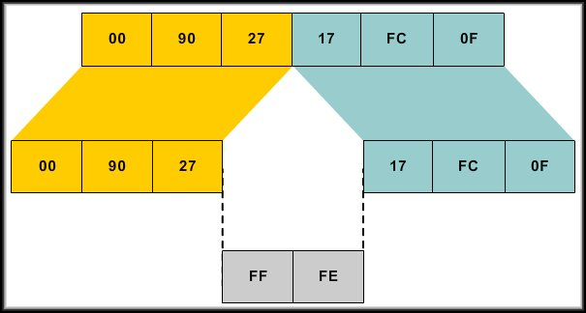
Using an EUI-64
42

Slide 43
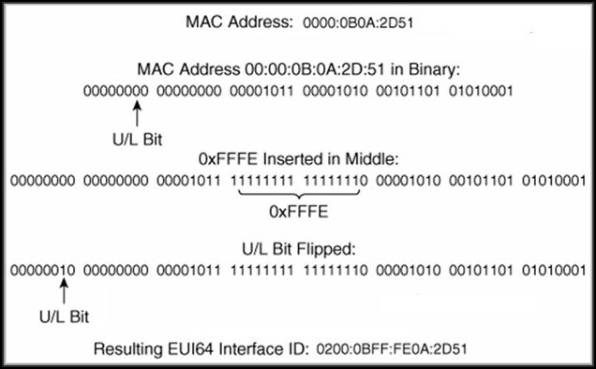
Using an EUI-64
Using EUI-64.
43

Slide 44
End of Part2

Slide 45
ICMPv6
Lecture 15 | Part 3 | CSE421 – Computer Networks

Slide 46
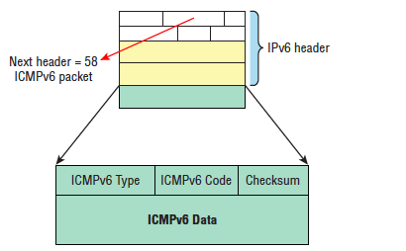
ICMPv6
it’s an integrated part of IPv6, not like IPv4
Is carried after the basic IPv6 header information as an extension header.
46

Slide 47
ICMP v6
By default, it prevents IPv6 from doing any fragmentation through an ICMPv6 process called path MTU discovery
The Address Resolution Protocol is used to perform this function for IPv4, but that’s been renamed neighbor discovery (ND) in ICMPv6.
47

Slide 48
ICMPv6
Neighbor discovery enables these functions:
Determining the MAC address of neighbors
Router solicitation (RS) FF02::2
Router advertisements (RA) FF02::1
Neighbor solicitation (NS)
Neighbor advertisement (NA)
Duplicate address detection (DAD)
48

Slide 49
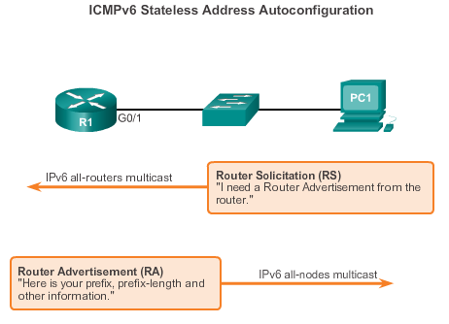
Stateless Address Auto configuration
Stateless Address Auto configuration (SLAAC) is a method in which a device can obtain an IPv6 global unicast address without the services of a DHCPv6 server.
Stateless as no server maintains network address information.
ICMPv6 RS msg
The RS message is ICMP type 133.
Using multicast address of FF02::2
ICMPv6 RA msg
49
Notes:
10.2.1.1 Stateless Address Autoconfiguration (SLAAC)

Slide 50
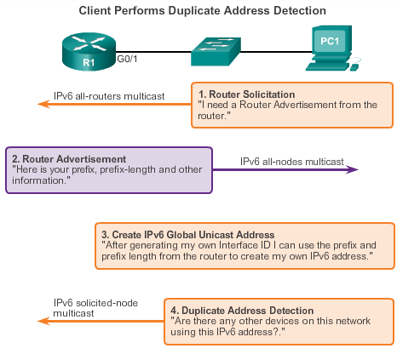
SLAAC Operation
Using either
EUI-64
Randomly Generated
Using ICMPv6 neighbor solicitation msg with the target address of its own.
Duplicate address detection (DAD)
50
Notes:
10.2.1.2 SLAAC Operation

Slide 51
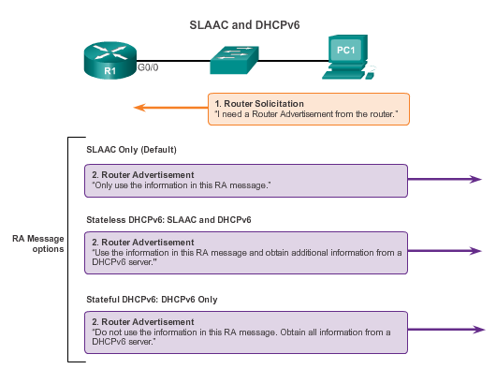
SLAAC and DHCPv6
51
Notes:
10.2.1.3 SLAAC and DHCPv6

Slide 52
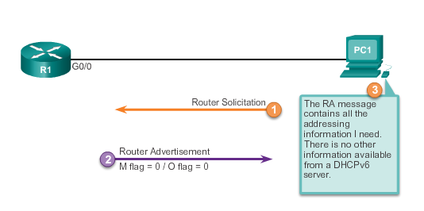
SLAAC Option
52
Notes:
10.2.1.4 SLAAC Option

Slide 53
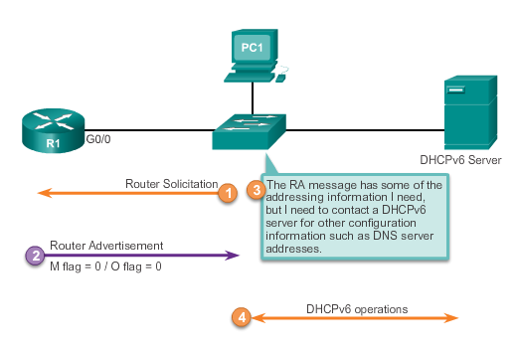
Stateless DHCP Option
1
53
Notes:
10.2.1.5 Stateless DHCP Option

Slide 54
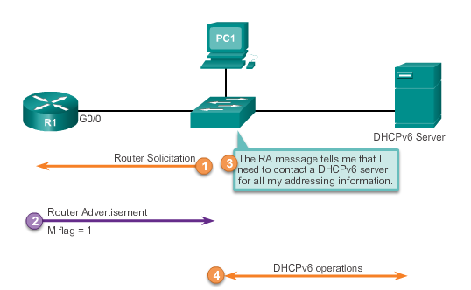
Stateful DHCP Option
54
Notes:
10.2.1.6 Stateful DHCP Option

Slide 55
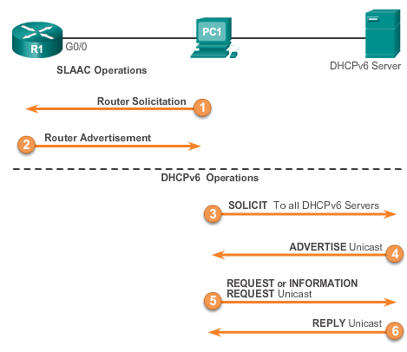
DHCPv6 Operations
Using reserved IPv6 multicast all-DHCP-servers-address FF02::1:2
Port 547
Server available for service
Stateless- INFORMATION REQUEST
Stateful - REQUEST
55
Notes:
10.2.1.7 DHCPv6 Operations

Slide 56
End of Part3

Slide 57
Transition from IPv4 to IPv6
Lecture 15 | Part 4 | CSE421 – Computer Networks

Slide 58
IPv4 to IPv6 Transition
Strategies and mechanisms:
IPv4 to IPv6 transition is gradual
IPv6 devices need to communicate to IPv4
IPv6 needs to communicate over IPv4 links
58
Notes:
IETF Transition mechanisms come under V6ops charter (was NGTrans working group until feb03)‏
http://www.ietf.org/html.charters/v6ops-charter.html
This should be a big topic, but I keep shortening it:
Summary is:
IPv6 traffic generally has to traverse IPv4 world or talk to IPv4 devices.
options:
Encapsulate it in IPv4 packets and route between two known end points.
Use tunnels such as 6to4 or Teredo for endpoints OR use compatible addresses OR mapped addresses
RFC1933 Transition Mechanisms for IPv6 Hosts and Routers
Rfc2766 NAT-pt Network Address Translation - Protocol Translation (NAT-PT)‏
NOTE: [should make this a slide]:
Dual stack node (host and router) does not mean having both IPv4 and IPv6 applications.
DNS name resolution doesn’t specify (IPv4/v6) version of peer application!
Dns lookup of ip6streamer.example.org may return IPv4 OR IPv6 OR BOTH v4&v6 addresses.
Can have various versions of an application. [e.g.: ssh tries IPv6 first and then if that times out drops back to IPv4).

Slide 59
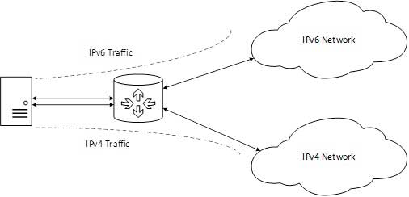
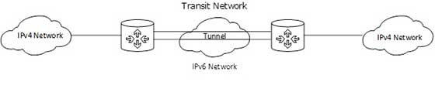
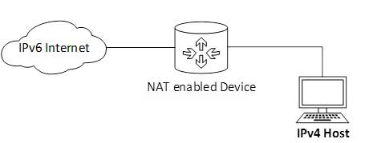
Transition Techniques
Three categories:
Dual-stack techniques
Tunneling Techniques
Translation techniques
59

Slide 60
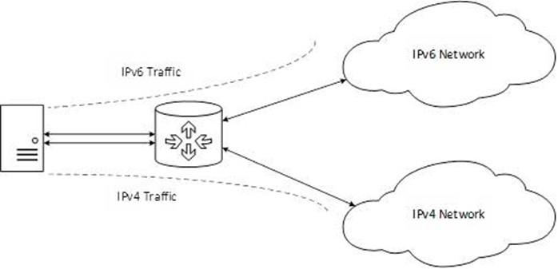
Dual Stack
Method in which a node has implementation and connectivity to both an IPv4 and IPv6 network.
The recommended option.
Involves running IPv4 and IPv6 at the same time.
60

Slide 61
Dual Stack
Applications on dual stack hosts:
For applications that only support IPv4 - use IPv4 only
For applications that support IPv6:
If DNS lookup of destination resolves address to IPv4 destination, use IPv4
If DNS resolves address to IPv6 destination use IPv6
Routers – send traffic based on IP type, and routing rules
61
Notes:
dual stack (IPv4 & IPv6) also rfc2893
* routers [Cisco IOS 12.2(2) starts IPv6 support]
* workstations - unix,linux,macosx10.2jaguar IPv6 production qualityish), windows 2k (experimental), XP (production IPv6 support)‏
http://www.ietf.org/html.charters/v6ops-charter.html
RFC: 2893 Transition Mechanisms for IPv6 Hosts and Routers
RFC:2473 encapsulation with IPv6 (tunnels IPv6) 3056 6to4
should we mention IPv6 MTU? MTU path discovery?
ISATAP draft-ietf-ngtrans-isatap-03.txt intra-site automatic tunnel addressing protocol.
The IPv6 Essentials O'Reilly book chapter 10 Interoperability (page 254 summary) is good.

Slide 62
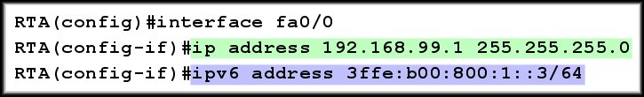
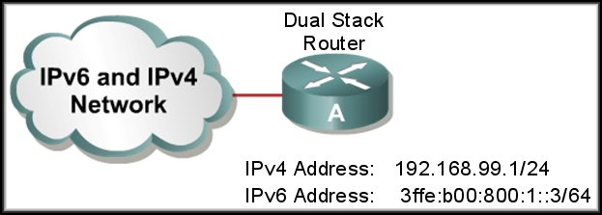
Cisco IOS Dual Stack
If both IPv4 and IPv6 addresses are configured on an interface, the interface is considered dual stacked.
62

Slide 63
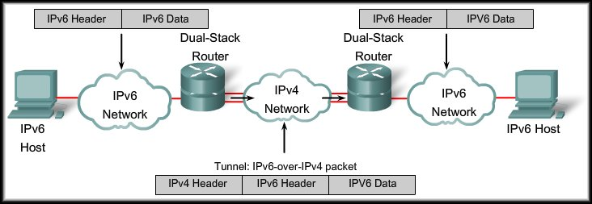
IPv6 Tunneling
Tunneling is an integration method where an IPv6 packet is encapsulated within another protocol.
Tunneling encapsulates the IPv6 packet in the IPv4 packet.
63

Slide 64
IPv6 Tunneling
When IPv4 is used to encapsulate the IPv6 packet:
Protocol type of 41.
20-byte IPv4 header with no options.
IPv6 header and payload.
Requires dual stacked routers.
64

Slide 65
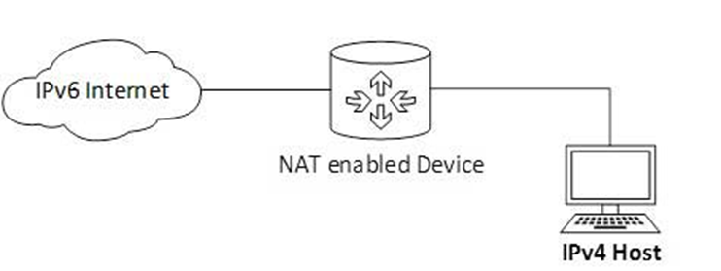
NAT Protocol Translation
Important method of transition to IPv6 by means of a NAT-PT (Network Address Translation – Protocol Translation) enabled device.
When the IPv4 host sends a request packet to the IPv6 server, the NAT-PT device/router strips down the IPv4 packet, removes IPv4 header, and adds IPv6 header and passes it through the Internet. When a response from the IPv6 server comes for the IPv4 host, the router does vice versa.
65

Slide 66
THE END

